Slide 1

BBA 3RD SEM Session(2022-23) OPERATIONS RESEARCH
Submitted By -
Shankh Bansal
AU22C1013
Submitted to -
Dr. Prachi Vasant

Slide 2

Index
What is Linear Programming? Objective Simplex Method Survey Solution Graphical Method Solution and Graph Conclusion

Slide 3
Project overview
Conduct a survey for the following scenarios, such as manufacturing problems, diet problems, transportation problems, allocation problems etc.
Construct the required equation and find optimal solutions using linear programming methods. ( Minimum 3 equations must be obtained.)
The optimal value can be either the maximum value or the minimum value.

Slide 4

What is linear Programming?
Linear programming is a mathematical optimization technique used to solve problems where the objective and constraints can be expressed as linear relationships. It involves maximizing or minimizing a linear objective function while subject to a set of linear constraints. The objective function represents the quantity to be optimized, such as profit or cost, while the constraints define the limitations or restrictions on the decision variables.

Slide 5
Objective
Understand the concept of linear programming and its applications in practical life and business.
Linear programming is used to find the best or optimal solution to a problem that requires a decision or set of decisions about how best to use a set of limited resources to achieve a state goal of objectives.

Slide 6

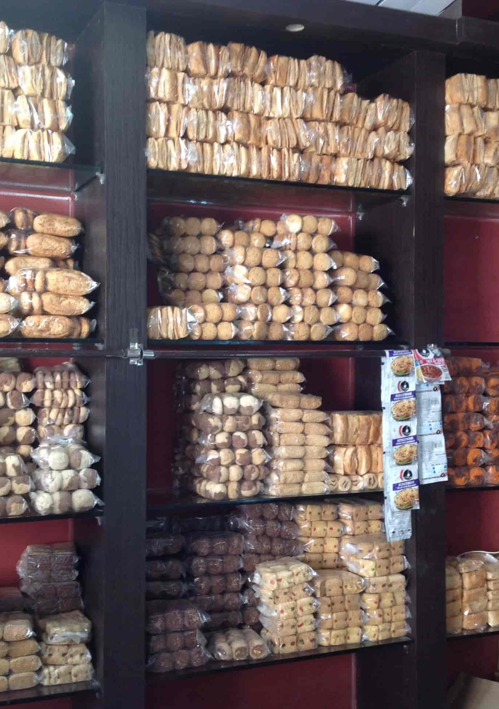
The Survey
I surveyed Shipra Bakery which is located in(Topp Khana ) Ujjain here we got to know the materials which are required to make biscuits and how much profit they generate from selling different kinds of biscuits.

Slide 7

The Problem
One kind of biscuit requires 200gm flour 25gm fat & 100gm sugar, the other type of biscuit requires 100gm flour 50gm fat & 50gm sugar. Find the maximum number of biscuits that can be made from 5kg flour, 1kg fat & 2kg sugar.

Slide 8
Simplex method
The Simplex method is an approach to solving linear programming models by hand using slack variables, tableaus, and pivot variables as a means to finding the optimal solution to an optimization problem.

Slide 9

Steps
Step 1: Standard Form.
Step 2: Determine Slack Variables.
Step 3: Setting up the Tableau.
Step 4: Check Optimality.
Step 5: Identify Pivot Variable.
Step 6: Create the New Tableau.
Step 7: Check Optimality.
Step 8: Identify New Pivot Variable.
Step 9: Create new table.
Step 10: Cheak Optimality.
Step 11: Identify optimal values.

Slide 10
Equations
Maximum Z = x1 + x2
Subject:
200x1 + 100x2 <= 5000
25x1 + 50x2 <= 100
100x1 + 50x2 <= 2000
X1, x2 >= 0

Slide 11
Table - 1
V | CB | 1 | 1 | 0 | 0 | 0
 |  | X1 | X2 | S1 | S2 | S3 | CJ | RATIO
S1 | 0 | 200 | 100 | 1 | 0 | 0 | 5000 | 25
S2 | 0 | 25 | 50 | 0 | 1 | 0 | 1000 | 40
S3 | 0 | 100 | 50 | 0 | 0 | 1 | 2000 | 20
TOTAL |  | -1 | -1 | 0 | 0 | 0
-1= CB*X1-Objective function of x1 ((0*200+0*25+0*100)-1) -1= CB*X2-Objective Function of x2 ((0*100+0*50+0*50)-1)

Slide 12
Table - 2
V | CB | 1 | 1 | 0 | 0 | 0
 |  | X1 | X2 | S1 | S2 | S3 | CJ | RATIO
S1 | 0 | 0 | 0 | 1 | 0 | -2 | 1000 | -
S2 | 0 | 0 | 75/2 | 0 | 1 | -1/4 | 500 | 40/3
X1 | 1 | 1 | 1/2 | 0 | 0 | 1/100 | 20 | 40
TOTAL |  | 0 | -1/2 | 0 | 0 | 1/100
X1 is calculated by dividing the key element i.e. 100 by the equation of S2.
S2 & S1 are calculated in the working notes given below.
 | X1 | X2 | S1 | S2 | S3 | CJ
Old V. | 25 | 50 | 0 | 1 | 0 | 1000
New W. | 25 | 25/2 | 0 | 0 | 1/4 | 500
 | 0 | 75/2 | 0 | 1 | -1/4 | 500
 | X1 | X2 | S1 | S2 | S3 | CJ
Old V. | 200 | 100 | 1 | 0 | 0 | 5000
New V. | 200 | 100 | 0 | 0 | 2 | 4000
 | 0 | 0 | 1 | 0 | -2 | 1000
Working note for S2
Working note for S1

Slide 13
Table - 3
V | CB | 1 | 1 | 0 | 0 | 0
 |  | X1 | X2 | S1 | S2 | S3 | CJ
S1 | 0 | 0 | 0 | 1 | 0 | -2 | 1000
X2 | 1 | 0 | 1 | 0 | 2/75 | -1/50 | 40/3
X1 | 1 | 1 | 0 | 0 | -1/75 | 4/300 | 40/3
 |  | 0 | 0 | 0
 | X1 | X2 | S1 | S2 | S3 | CJ
Old V. | 1 | 1/2 | 0 | 0 | 1/100 | 40
New W. | 0 | 1/2 | 0 | 1/75 | -1/300 | 80/3
 | 1 | 0 | 0 | -1/75 | 4/300 | 40/3
 | X1 | X2 | S1 | S2 | S3 | CJ
Old V. | 0 | 0 | 1 | 0 | -2 | 1000
New V. | 0 | 0 | 0 | 0 | 0 | 0
 | 0 | 0 | 1 | 0 | -2 | 1000
Working note for X1
Working note for S1

Slide 14
SOLUTION
X1 = 40/3
X2 = 40/3
Maximum Z = X1 + X2
Z = 40/3 + 40/3
Z = 80/3
Z = 26
The Bakery is producing the same number of biscuits which is 13, 13.

Slide 15
Graphical Method
The graphical method is used to optimize the two-variable linear programming. If the problem has two decision variables, a graphical method is the best method to find the optimal solution. In this method, the set of inequalities are subjected to constraints. Then the inequalities are plotted in the XY plane.

Slide 16
S T E P S
Step 1
Formulate the LP (Linear programming) problem.
Step 2
Construct a graph and plot the constraint lines.
Step 3
Determine the valid side of each constraint line.
Step 4
Identify the feasible solution region.
Step 5
Plot the objective function on the graph.
Step 6
Find the optimum point.

Slide 17
Equations
Maximum Z = x1 + x2
Subject:
200x1 + 100x2 <= 5000
25x1 + 50x2 <= 100
100x1 + 50x2 <= 2000
X1, x2 >= 0

Slide 18
Finding Values
2X1 + X2 = 50
X1 + 2X2 = 40
2X1 + X2 = 40
X1/25 , X2/50
X1/40 , X2/20
X1/20 , X2/40
Dividing by 50
Dividing by 40
Dividing by 40

Slide 19
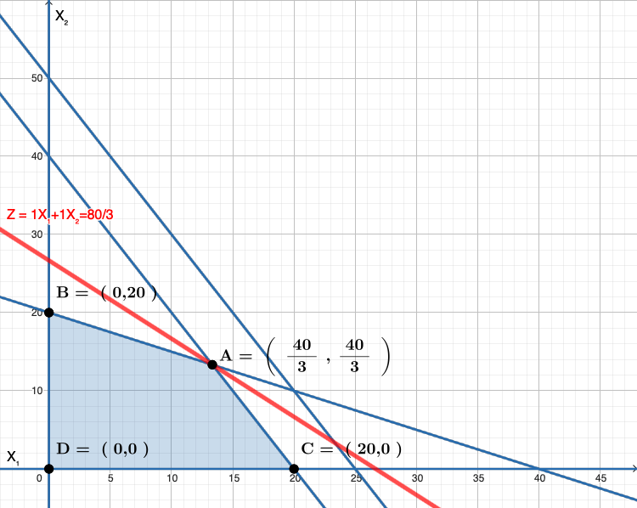
The graph
Maximum Z = 40/3 +40/3 = 80/3

Slide 20
Conclusion
Linear programming has numerous applications in daily life and can provide valuable solutions to various real-world problems. Here are a few examples:
Diet and Nutrition
Scheduling and Time Management
Financial Planning
Supply Chain Management

Slide 21

Thank You

